Slide 1


Slide 2

Online examination system
EXAMBUZZ

Slide 3

COLLABORATORS
MUSKAN MATHUR
NIKHIL PAREEK
AYUSH JAIN
SHIVANSH MAHESHWARI
NOBLE RATHI
PANKAJ MEMROT

Slide 4



ACKNOWLEDGMENT
GRRAS SOLUTION pvt.ltd.
JECRC
RCEW
MR. SANJAY RATHORE
MR. ANKUSH SHARMA
MR. SANJAY GAUR (HOD, CSE)
MR. VINEET KHANNA (HOD,CSE)

Slide 5
Abstract
ExamBuzz is a Multiple-Choice Questions (MCQ) based examination system. It provides an easy to use environment for both Test Conductors and Students appearing for Examination.
The purpose of ExamBuzz test simulator is to take online test in an efficient manner and no time wasting for checking the paper.
It efficiently evaluate the candidate thoroughly through a fully automated system that not only saves a lot of time but also gives fast results and saves test without using extra thing like paper, pen etc.

Slide 6





Overview
ExamBuzz has following stages:
• Sign Up
• Login
• Created papers
• Joined papers
Check results
• View profile
• Update profile
Logout

Slide 7






Technologies Used
Front end as:
HTML 5, CSS 3, Bootstrap, Angular, JavaScript, Typescript, Font Awesome
Back end as:
Express.js, Node.js, JavaScript
Database:
MongoDB Atlas
VCS and Server
Git and GitHub respectively

Slide 8
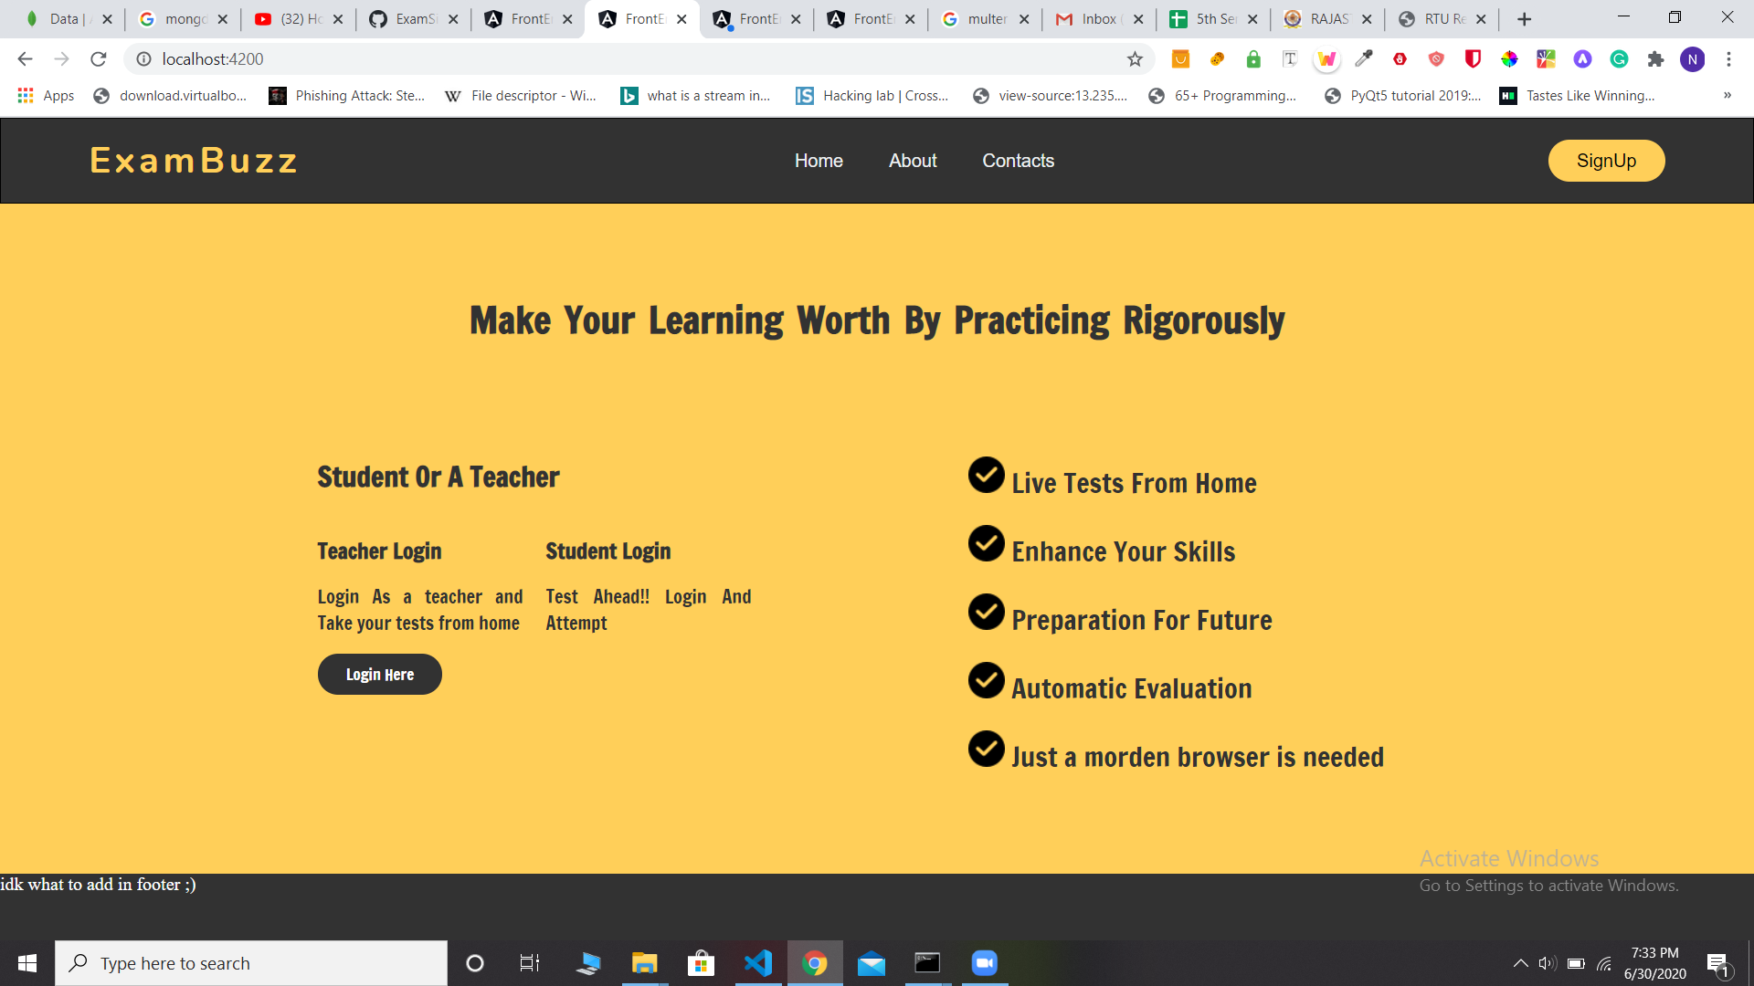

Slide 9
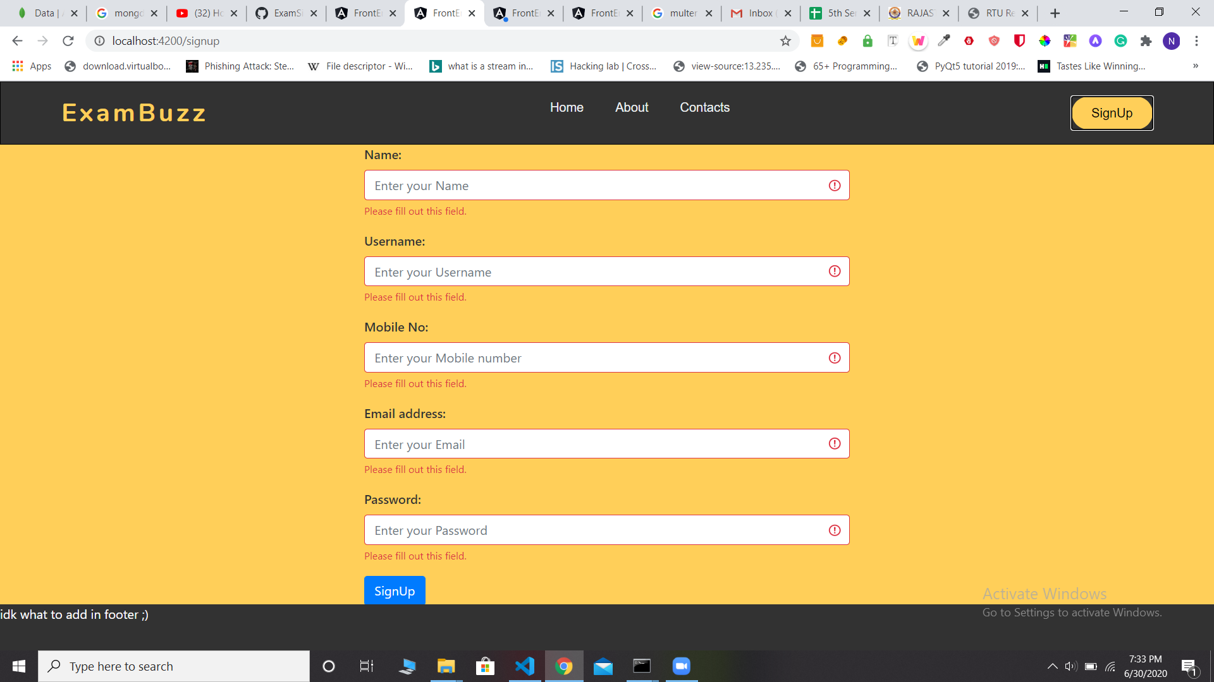

Slide 10
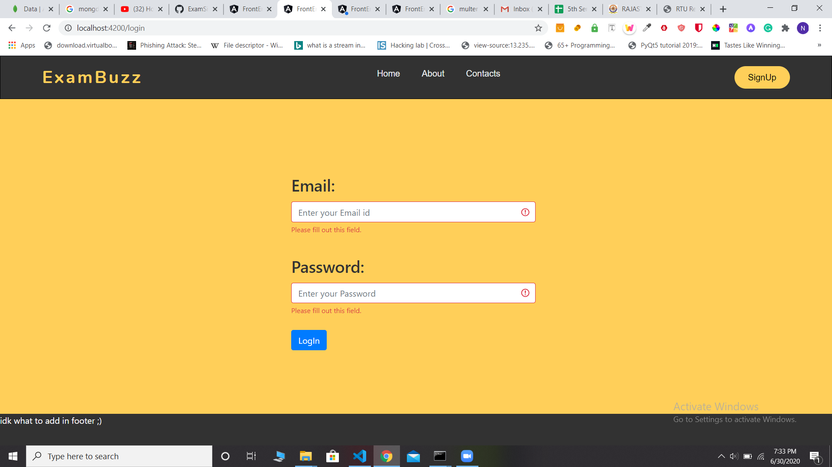

Slide 11
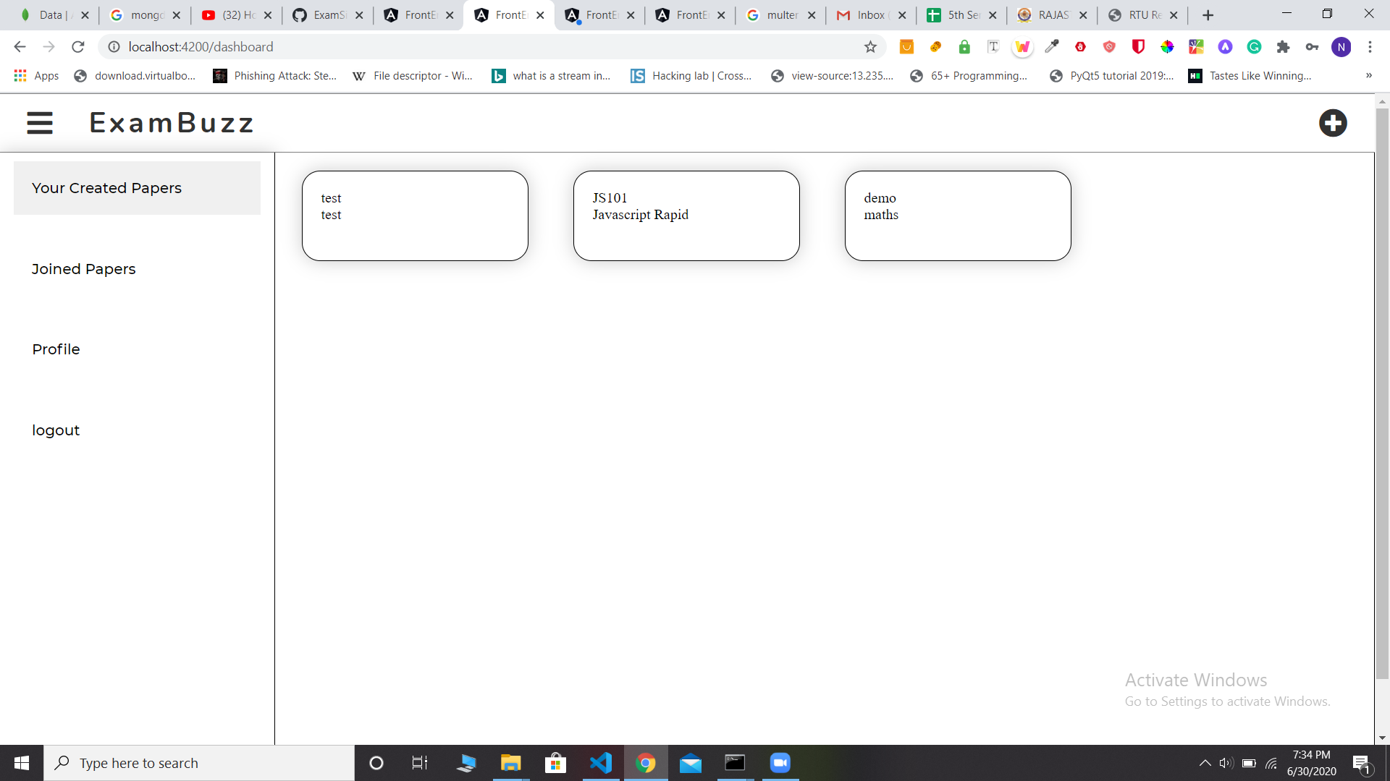

Slide 12
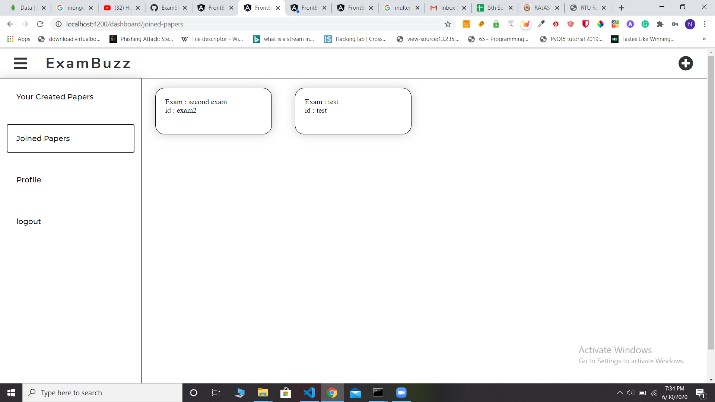

Slide 13
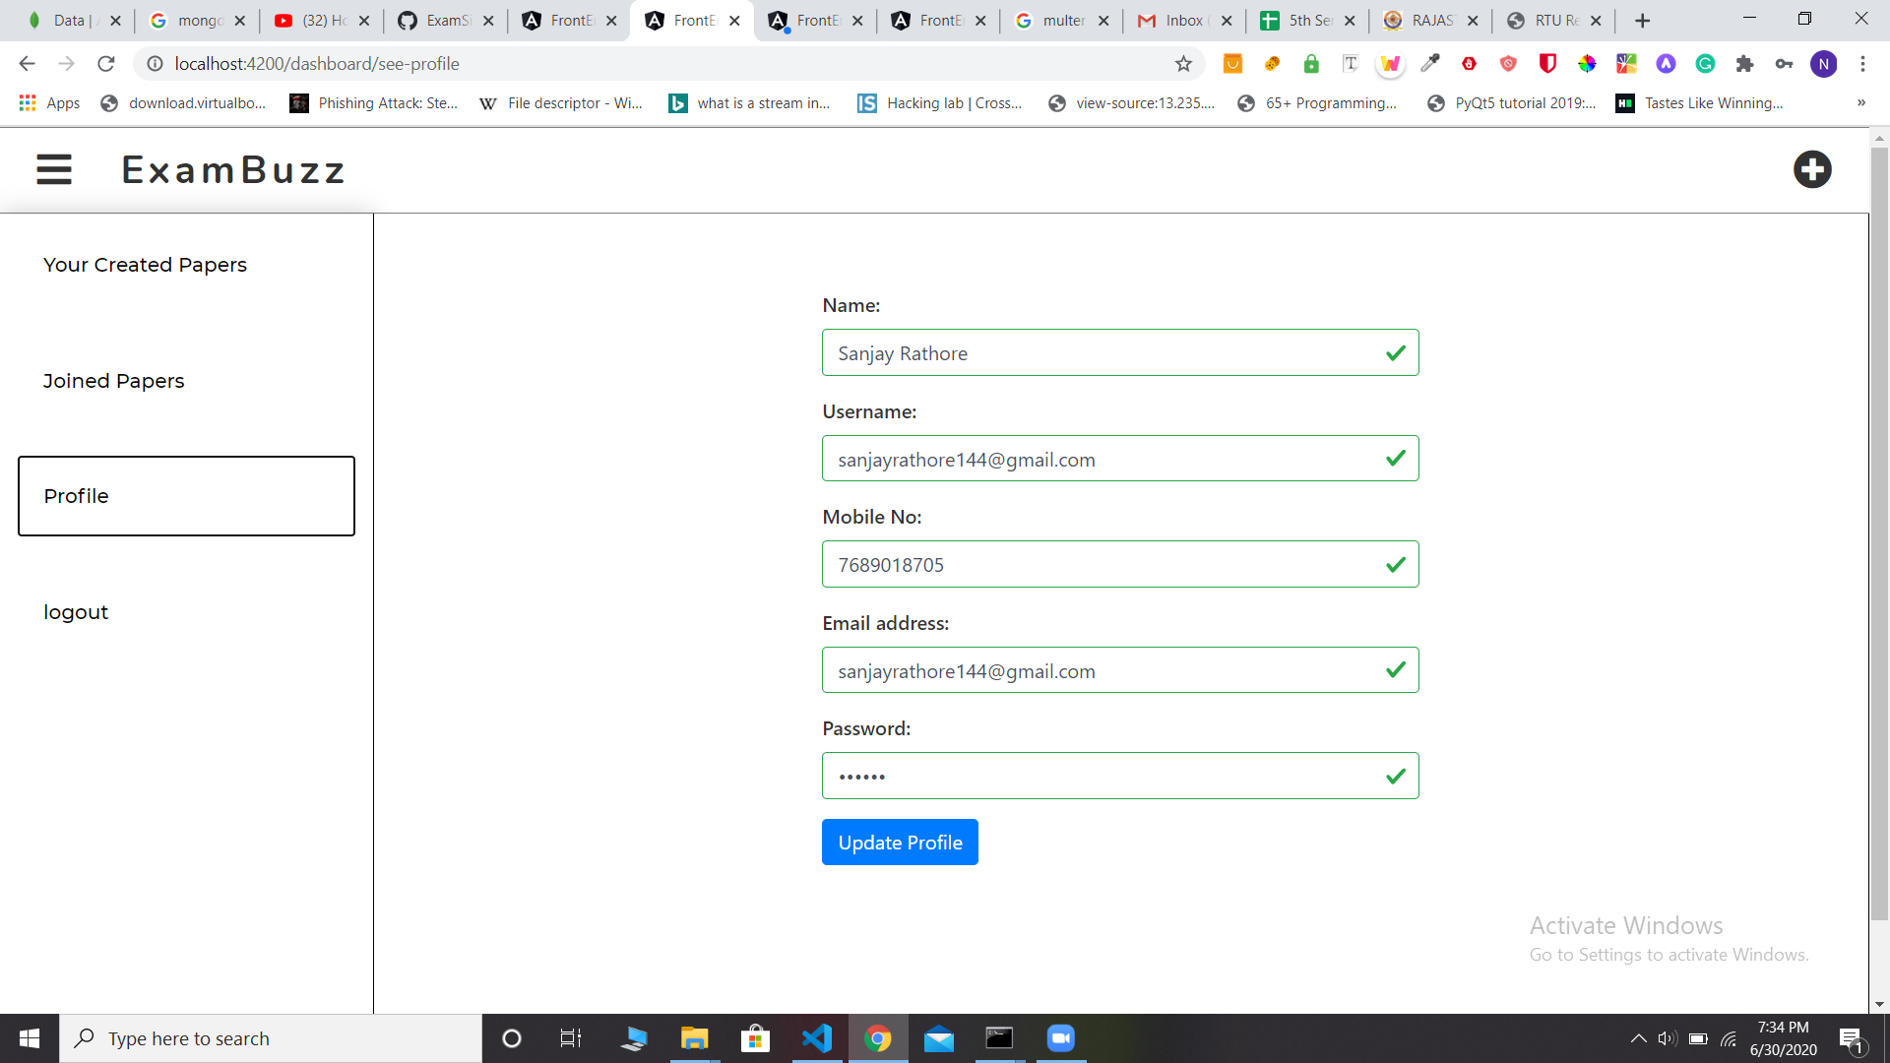

Slide 14
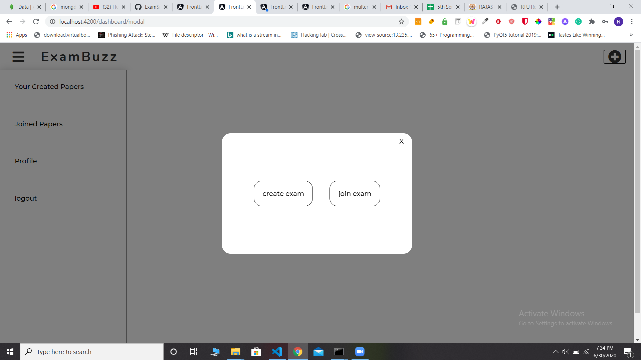

Slide 15


Slide 16
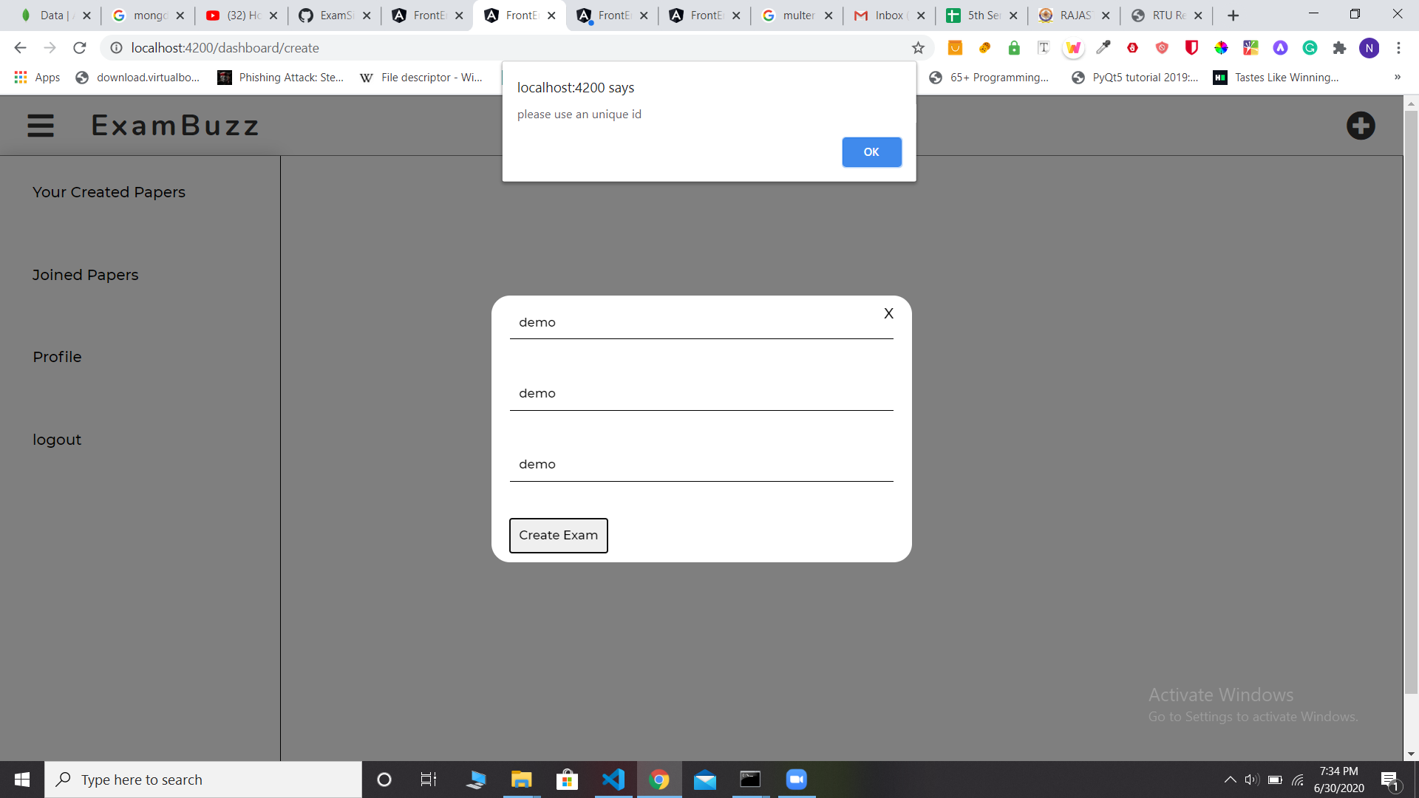

Slide 17
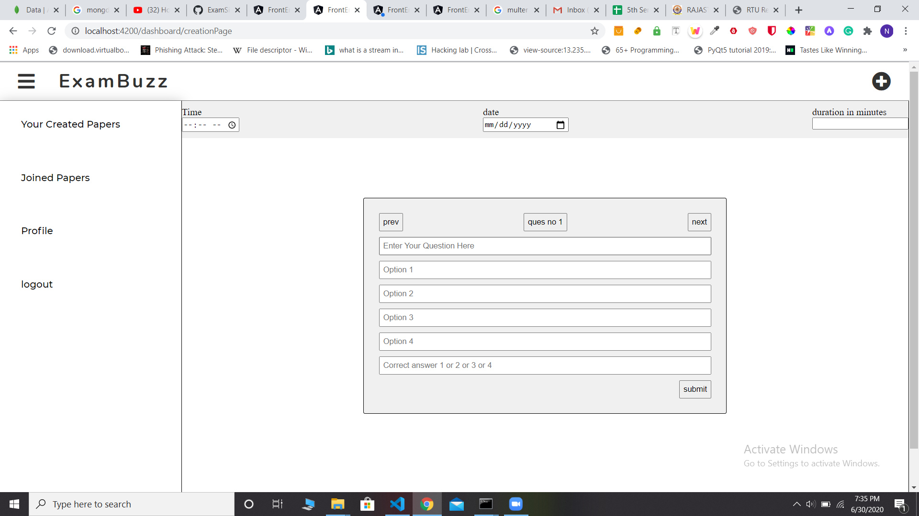

Slide 18
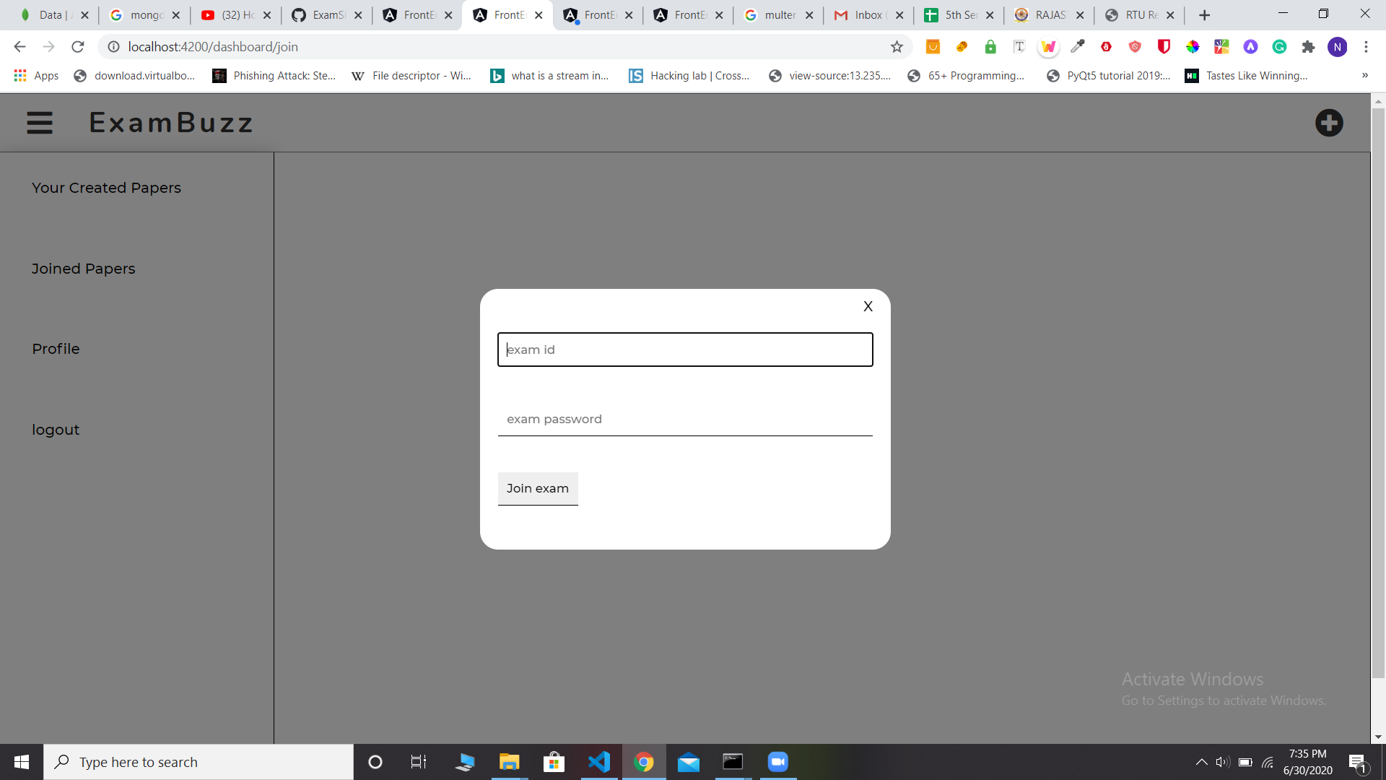

Slide 19
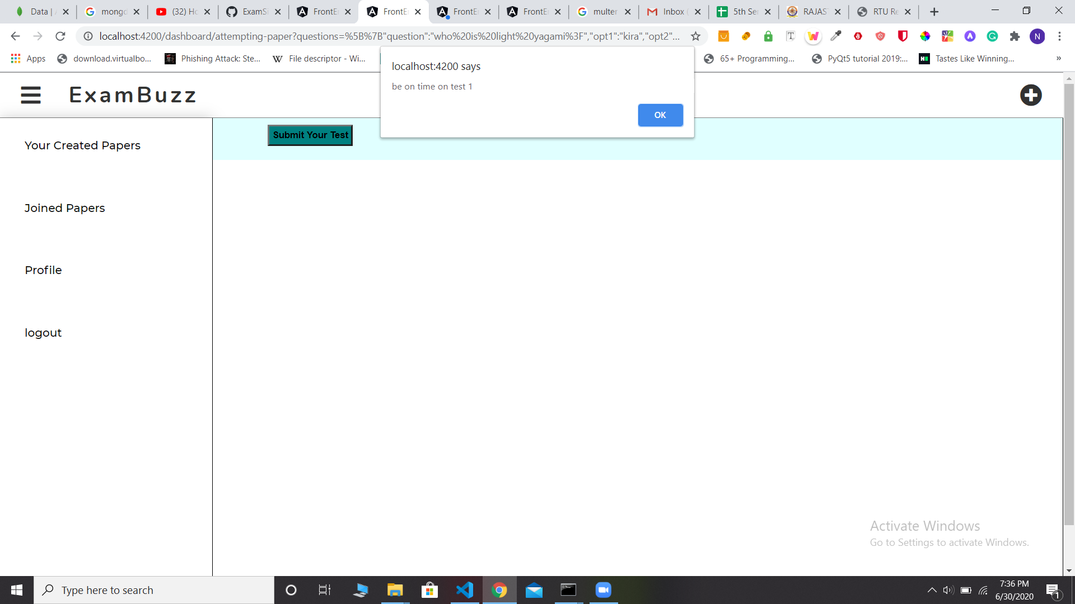

Slide 20
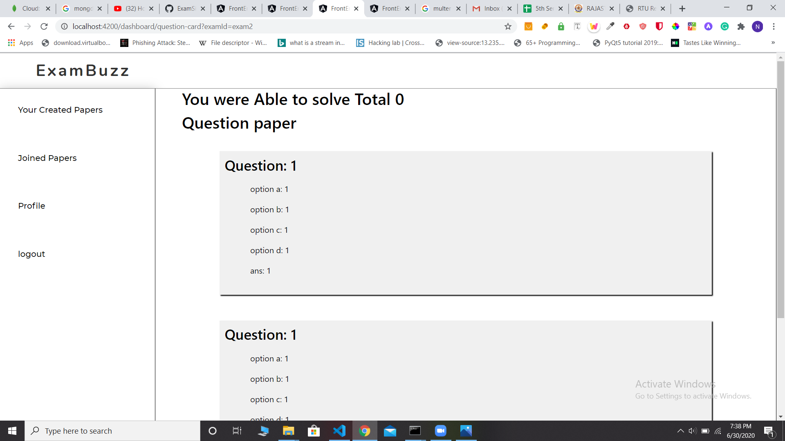

Slide 21
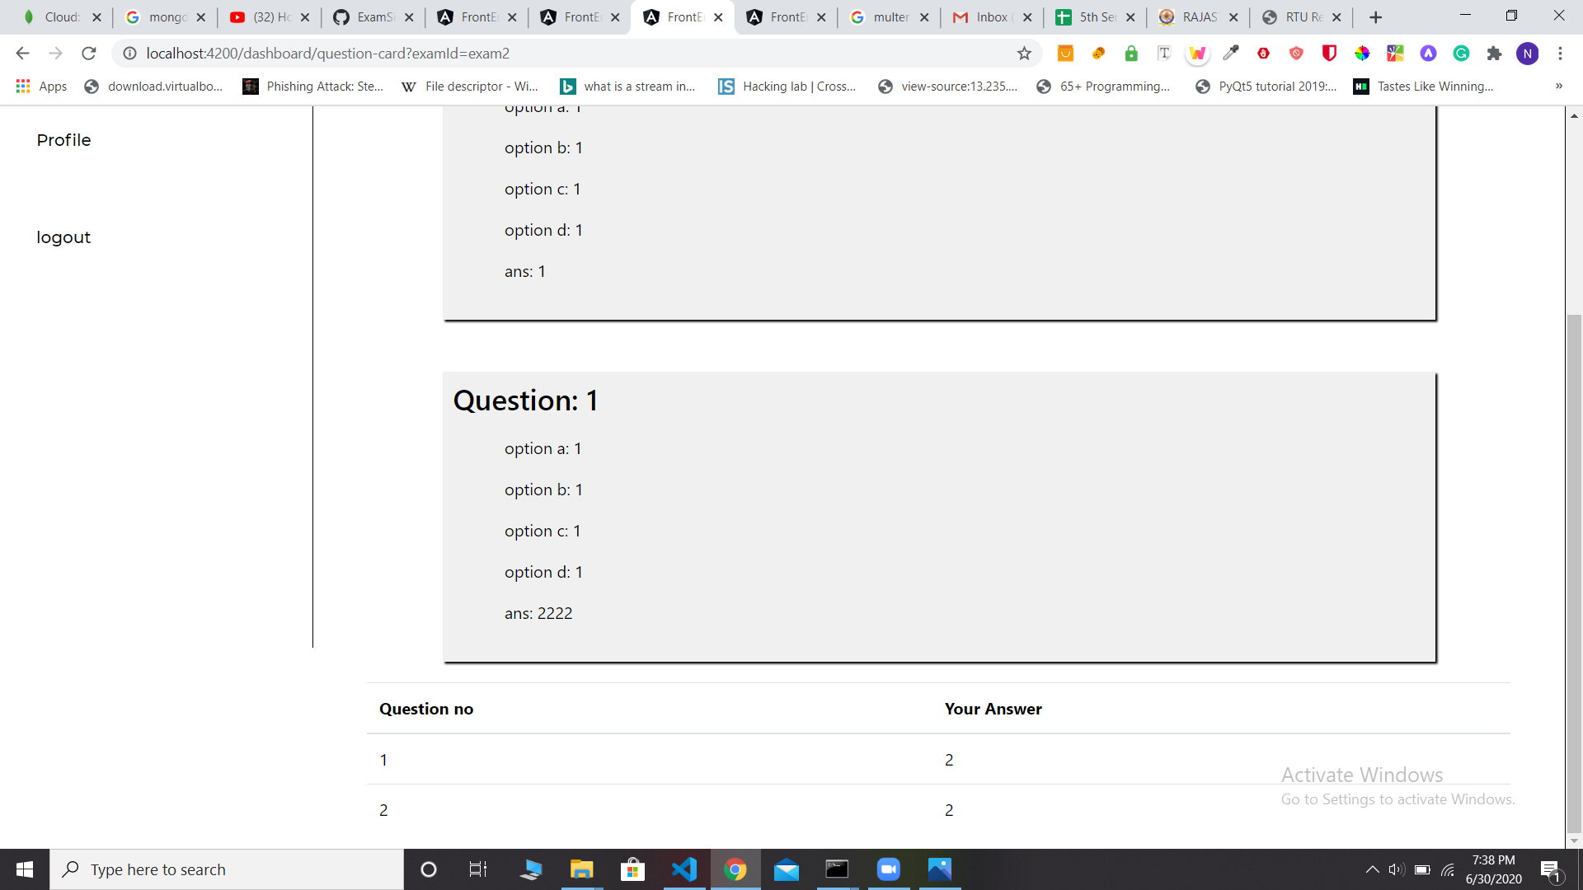

Slide 22
Future Scope
The questions are shuffled in a random order so that possibilities for getting questions in the same order for the students who are besides, is very less.
Gives the list of attempted and unattempt questions and can go to any question directly and can either attempt or change the answer of the already attempted questions

